Slide 1
The Bootstrap Method
Saima Khan
ID: 181-35-2392
Presented To:
Musabbir Hasan Sammak
Lecturer, Daffodil International University

Slide 2
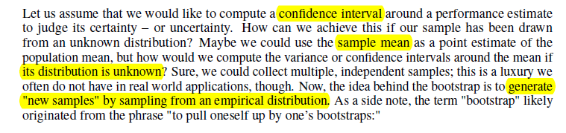
The Bootstrap Method

Slide 3
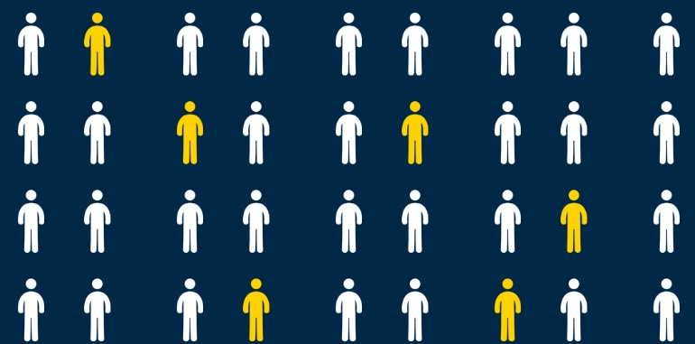
What is Bootstrap Method?

Slide 4
The bootstrap method is a resampling technique for estimating a sampling distribution, and in the context of this article, we are particularly interested in estimating the uncertainty of a performance estimate – the prediction accuracy or error.
The bootstrap method was introduced by Bradley Efron in 1979 [Efron, 1992].

Slide 5
In statistics, Bootstrap Sampling is a method that involves drawing of sample data repeatedly with replacement from a data source to estimate a population parameter.
3 key points -
Parameter estimation
Sampling with replacement
Sampling

Slide 6
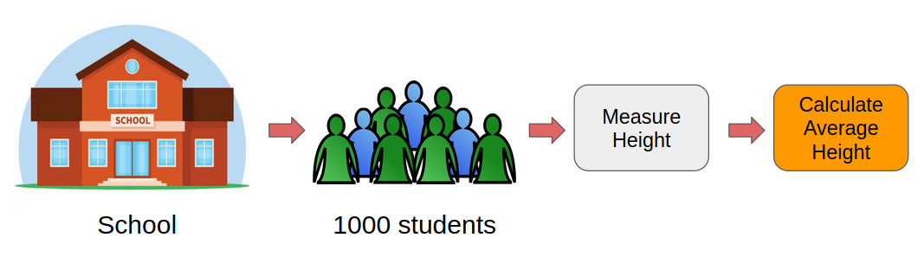
Why Do We Need Bootstrap Sampling?
Let’s say we want to find the mean height of all the students in a school (which has a total population of 1,000). So, how can we perform this task?

Slide 7
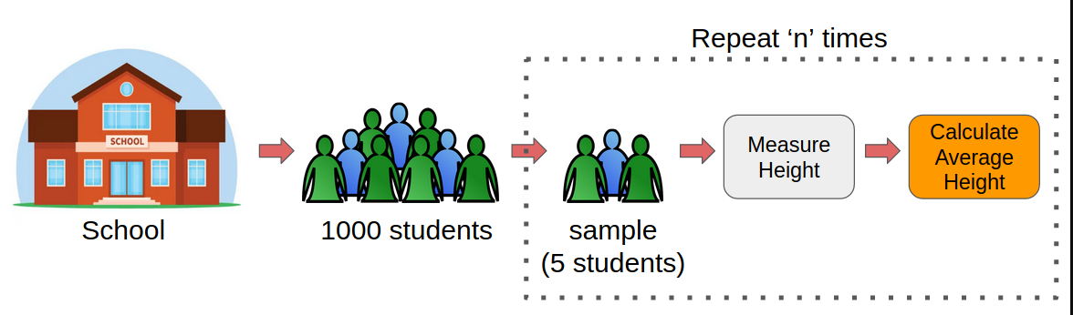
This is where Bootstrap Sampling comes into play!
Hence, when we have to estimate a parameter of a large population, we can take the help of Bootstrap Sampling.

Slide 8
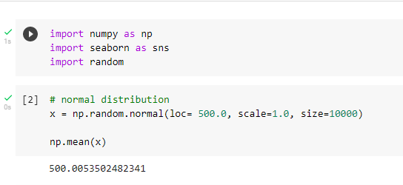
Implement Bootstrap Sampling in Python
A Gaussian distribution (population) of 10,000 elements is created with the population mean being 500.

Slide 9
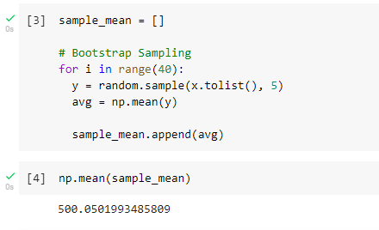
Now, 40 samples of size 5 from the distribution (population) is drawn and computed the mean for every sample:
Code url:
https://colab.research.google.com/drive/1sTLFiWkmvZ1lE7GBePPjJ6rea_-E7Knv#scrollTo=Vpus1mVpW7J8

Slide 10
Summary
In brief, the idea of the bootstrap method is to generate new data from a population by repeated sampling from the original dataset with replacement – in contrast, the repeated holdout method can be understood as sampling without replacement.
In order to exploit the method for the evaluation of predictive models, such as hypotheses for classification and regression, we may prefer a slightly different approach to bootstrapping using the so-called Leave-One-Out Bootstrap (LOOB) technique.

Slide 11
Thank You

